Slide 1
IMSE 991 Multiple Criteria Decision Making
Lecture 3
Metrics and Data Analysis

Slide 2
Metrics and Data Analysis
Assess the Information and Its Availability
Data Summarization
Analysis and Forecasting
Key Concepts Logistics Pipeline Analyzer

Slide 3
Metrics and Data Analysis
As we build MCDM models, we need to ensure that we have accurate data to support the model
Data can be subjective or objective, but should be understood prior to making decisions from our model
In the previous lecture, we discussed
Establishing goals, objectives and decision criteria
Group decision making techniques to build consensus and expert opinion
This lecture, we will discuss methods to assess and analyze the data that we use in our decision model

Slide 4
Metrics and Data Analysis
Who should be involved?
Subject matter experts and decision modelers are engaged to
Analyze operational data
Quantify performance
Identify improvement opportunities
Engage the individuals who perform these functions and generate the originating data

Slide 5
Assess the Information and Its Availability
After the structure and definition of the problem have been determined, the next step is to perform various data and statistical analysis with the available information.
It can be challenging to sift through the various sources and types of information available.

Slide 6
Assess the Information and Its Availability
Sometimes, data is all that you need to solve a problem.
Other times, you may need data and statistical analysis to model the problem.

Slide 7
Assess the Information and Its Availability
You can use various approaches, such as the following:
Data queries, groupings, and summaries: Databases, spreadsheets.
Statistical analysis: Mean, standard deviation, variance, regression analysis.
Forecasting: Moving averages, exponential smoothing.
Future predictions: Expert opinion.

Slide 8
Assess the Information and Its Availability
Some relatively easy methods to gain data insights are:
Graphing data to identify trends.
Statistical methods to determine basic characteristics of the data.
Forecasting on historical data to determine data fit and predictors.
Expert opinion to project future data characteristics.
Neural networks to provide a statistical basis for forward projections with large amounts of data.

Slide 9
Assess the Information and Its Availability
Variability analysis is key to understanding process control:
Statistical models for control charts
Safety stock analysis
Variability measures and tools assist in determining:
Service levels for product availability
Production and capacity constraints
Operational control
Focus areas for improvement

Slide 10
Assess the Information and Its Availability
Key in data analysis is to determine what the information can tell you about the operation.
Don’t analyze data for analysis sake—look for insights into operations from the results of the analysis.
Understand the correct operational context of the information.
Understand how the data and metrics fit in the overall processes.
Assess what you know and don’t know from the analysis.
Look to find “the story” that the data is telling.

Slide 11
Assess the Information and Its Availability
The business environment, objectives, availability of data, and the time available dictate methods used for model development:
Select methods based on the time frame available to provide directional information.
Combine methods to represent the operating environment.
Assess the data to ensure that you are using the right models for the data available.

Slide 12
Assess the Information and Its Availability
Decision maker’s understanding of methods:
It is mandatory to keep the decision methods understandable to the decision maker.
Decision makers must be comfortable and confident in the methods chosen.
Decision makers must be able to explain the models to higher-level management/executives.
The simpler the method, the better.

Slide 13
Assess the Information and Its Availability
Integrating the data analysis, the solution process, together with the decision-maker goals, ensures that the model can support the decision to be made.

Slide 14
Assess the Information and Its Availability
Use automated tools to capture the model:
Spreadsheets
Databases
Databases and spreadsheets integrated with user-friendly interfaces
Full computer software systems
Computer applications networked within a company

Slide 15
Assess the Information and Its Availability
Automating models provides the ability to easily perform sensitivity analysis and test various scenarios and parameters.
Easily updated models can adapt to the dynamics of the business.

Slide 16
Data Summarization
Understand the data available from computer systems and information flow.
Understand the availability of data and the ease of accessing the data helps to formulate the appropriate model.

Slide 17
Data Summarization
Data from one functional area may be useful in other functional areas:
Data from production may be useful in distribution.
Data from projects may be useful in skill set analysis.
Data from various functional areas may provide insights into the overall operations.

Slide 18
Data Summarization
Queries and Summaries
Data can be analyzed in its basic state.
Data can be aggregated to a higher-level view.
Use readily available products – MS Office
There is no predetermined analysis that should be performed on data.
Allow results from one analysis to lead to other insightful analyses of the information.

Slide 19
Data Summarization
Queries and Summaries
Summarize high-level performance indicators to compare and contrast operational performance.
Determine high and low performers to determine opportunity areas.
Example: The Business and Consumer ordering system performance is not performing as well as the Dealer and Internet systems.

Slide 20
Data Summarization
Queries and Summaries
Not all data may be “good” or “complete;” however, this may be the only data available.
Incomplete data can still provide valuable insights.
Quantify data weaknesses and assumptions using the data.
Use compensatory methods for data incompleteness such as expert opinion and projections to fill in missing information.

Slide 21
Data Summarization
Data Groupings
Company data may provide too much detail for the decision maker.
Data can be summarized into logical groupings to better represent the data and gain understanding:
Similar operating characteristics
Groups of like parts
These groupings may simplify the model so that it is manageable.

Slide 22
Data Summarization
Data Groupings
The Central Limit Theorem may be used to justify grouping and analyzing data:
The normal distribution provides a good approximation to the sampling distribution of the means when the number of samples is small (25-30).
For random samples from a normal population, the sampling distribution is normal regardless of the size of the sample.
You can then use standard, easily understood statistics to represent most data samples.
The “mean of the means” of any sample distribution can be approximated by the normal distribution

Slide 23
Data Summarization
Data Groupings
Example of data grouping from manpower planning study:
30,000 tasks recorded as part of a survey.
1,500 uniquely individual tasks performed within an organization.
The tasks were grouped into 24 major categories:
Provide general administrative support and maintenance
Develop and maintain information systems
Provide technical, analytical, and operational support
Attend training, etc.

Slide 24
Data Summarization
Data Groupings
Example of data grouping from manpower planning study (continued):
Within the 24 categories, the averages of individual tasks and the frequency of tasks were computed.
The average of averages (weighted by frequency) were computed.
Any task that fell into the 24 categories was assigned the task time for the sub category overall.
Average task times were based on the use of the Central Limit Theorem

Slide 25
Data Summarization
Data Groupings
Example of data grouping from manpower planning study (continued):
Reduced 30,000 tasks to 24 categories with their own statistical distributions.
Each task subcategory had an activity time profile:
Specific activities performed with each one of the 24 subcategories.
The average time to perform an activity in a task subcategory.
The frequency of each of the tasks within a task subcategory.
Variability of the average activity time of all tasks.

Slide 26
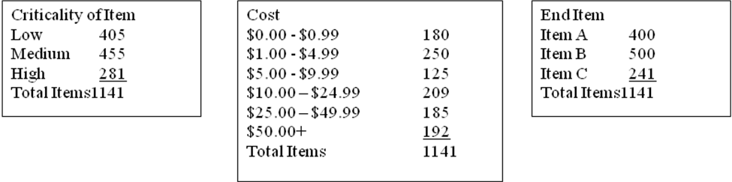
Data Summarization
Data Groupings
Example using criteria to group data and reduce the data set:
Identify sets of parameters that characterize the data—i.e., cost, criticality, and final assembly.
Develop ranges within the parameters that logically group the data, cost ranges ($0.00 - $0.99, $1.00 - $4.99, etc.), criticality ranges (low, medium, high), and end item (A, B, C, etc.).
Place items into a “market basket” that represents these characteristics.
In an example of 1,141 items, this would reduce to 6*3*3 = 54 items.

Slide 27
Standard Statistics
These statistical functions are readily available in MS Office software programs.
Mean: the arithmetic mean or average of the data set.
Low: the lowest value in the data set
High: the highest value in the data set
Median: the value that represents the middle of the data set when ordered
Mode: the most frequent value in the set of data

Slide 28
Standard Statistics
These statistical functions are readily available in MS Office software programs.
Standard deviation: The measure of dispersion of a frequency distribution (square root of variance)
Variance: The measure of dispersion of a frequency distribution (mean of the squares of the deviation from the arithmetic mean)

Slide 29
Histogram
Histogram
Frequency distribution divided by classes of data and plotted according to the frequency of the occurrence for each of the classes of data
A histogram can be developed using a line graph or with bar graphs.
Typically a histogram will be represented by integer groupings, i.e., 1 day or grouped into ranges such as 0–3 days, 4–6 days, and so on.

Slide 30
Frequency Distributions
Frequency Distribution for the Data Set by Deciles
A frequency distribution is divided into classes (e.g., ten classes) of data such that each class contains the same number of individual data points.
Ranges or averages associated with each of the classes of data would be displayed on a graphical plot of the information

Slide 31
Forecasting
Forecasting
A myriad of forecasting methods exist and discussed in statistics books/classes.
You can use forecasting techniques to predict future occurrences based on historical data.
The most common of the techniques are moving averages, exponential smoothing, and multiple regression analysis.

Slide 32
Moving Averages
Moving Averages
A moving average is a forecast of a future occurrence of an activity based on the most recent occurrences of the activity.
The simple moving average is the arithmetic mean of the n most recent observations.
Equal weights are assigned to the most recent n observations.
Each new estimate is computed by adding the new data point and discarding the oldest data point for the previous nth period.
Each new estimate is an updated version of the preceding estimate.
The rate of response of the moving average to changes in the underlying data pattern depends upon the number of periods included in the moving average.
In general, the more periods included in the computation, the less sensitive it will be to changes in the pattern of the data.

Slide 33
Moving Averages
Development of Moving Averages Method
The simple moving average model is given by the formula where
m_{t} = moving average at time t
y_{t} = actual value in period t
n = number of terms included in the moving average
The simple moving average is the arithmetic mean of the n most recent observations.
The moving average for three periods in the future is computed using the moving average values for periods 1 and 2 in the future.

Slide 34
Moving Average Example
Three and five month moving average
Month | Quantity | 3-Month Moving Average | 5- Month Moving Average
January | 1325
February | 1353
March | 1305
April | 1275 | 1328
May | 1210 | 1311
June | 1195 | 1263 | 1294
July | ? | 1227 | 1268

Slide 35
Moving Average Example
Three and five month moving average
Note the sensitivity to the most recent observations

Slide 36
Weighted Moving Averages
Weighted Moving Averages
A weighted moving average forecast is similar to a moving average
The weighted moving average enables the observations to be weighted such that more importance can be attached to the more recent observations.

Slide 37
Weighted Moving Averages
The weighted moving average model is given by the formula:
Where
m_{t} = weighted moving average at time t
y_{t} = actual value in period t
n = number of terms included in the moving average
w_{t} = weight on observation for period t
The weights should be normalized and sum to 1.
=1

Slide 38
Weighted Moving Averages
How do we decide on the weights? Depends on:
The importance that we feel past data has
Known seasonality
Other insights we have with the data

Slide 39
Weighted Moving Averages
Month | Quantity | 3-Month Moving Average | Weights for 3-Month Moving Average | Weighted 3-Month Moving Average | 5- Month Moving Average | Weights for 5-Month Moving Average | Weighted 5-Month Moving Average
January | 1325
February | 1353 |  |  |  |  | 10%
March | 1305 |  |  |  |  | 10%
April | 1275 |  | 20% |  |  | 20%
May | 1210 |  | 30% |  |  | 30%
June | 1195 |  | 50% |  |  | 30%
July |  | 1227 |  | 1216 | 1268 |  | 1242

Slide 40
Weighted Moving Averages
Forecasts can differ significantly based on the method used.

Slide 41
Exponential Smoothing
Exponential Smoothing
New forecasts are derived by adjusting forecasts made for previous periods by considering their forecast errors.
The forecaster can continually revise the forecast based on past experience.
This model has the advantage of a weighted moving average method, in that more recent observations are assigned larger weights.
Single exponential smoothing is a procedure in which the forecast for the next period equals the forecast for the prior period, adjusted by an actual amount.
Double exponential smoothing may also be used to address trends in the data.

Slide 42
Exponential Smoothing
Exponential Smoothing
The smoothing constant a must be determined judgmentally, depending on the sensitivity of the response the model requires.
The smaller the value of a, the slower the response. Larger values of a cause increasingly quicker reactions in the smoothed (forecast) value.
It is difficult with this method to try forecast more than one period ahead.

Slide 43
Exponential Smoothing
Exponential Smoothing Method
where
s₀ = initial estimate of the smoothed value

Slide 44
Exponential Smoothing
The initial estimate s₀ of the smoothed value can be estimated from historical data by using a simple average of the most recent observations.
The smoothing constant α must be determined judgmentally, depending on the sensitivity of response the model requires.
The smaller the value of α, the slower the response.
Some textbooks recommend that α should lie somewhere between 0.01 and 0.40.

Slide 45
Exponential Smoothing
Why Use Exponential Smoothing
Uses less storage space for data
Very accurate
Easy to understand
Little calculation complexity

Slide 46
Exponential Smoothing
Month | Actual | α = .2 | α = .8
January | 1325 | 1370 | 1370
February | 1353 | 1361 | 1334
March | 1305 | 1359 | 1349
April | 1275 | 1349 | 1314
May | 1210 | 1334 | 1283
June |  | 1309 | 1225

Slide 47
Exponential Smoothing

Slide 48
Regression Analysis
Regression Analysis
Determines the relationships between the dependent and independent variables and represents this relationship in a regression equation.
The results of this statistical analysis can be shown in an equation, in tables, or by plotting the regression line for the data set.
Regression is a functional relationship between two or more correlated variables that is often empirically determined from data and is used to predict values of one variable when given values of the others.

Slide 49
Regression Analysis
Regression Analysis Method
You can use regression analysis to predict future requirements or activities based on variables input into the regression equations.
The general form of the regression equations used in this analysis is shown here:
where a_{i} is the coefficient of each input variable, x_{i} is the actual value of the input variable, and b is the intercept.

Slide 50
Regression Analysis
Excel Example
Month | Month | Quantity
January | 1 | 1325
February | 2 | 1353
March | 3 | 1305
April | 4 | 1275
May | 5 | 1210
June | 6 | 1195
July | 7

Slide 51
Regression Analysis
SUMMARY OUTPUT
Regression Statistics
Multiple R | 0.935387712
R Square | 0.874950172
Adjusted R Square | 0.843687715
Standard Error | 25.05546229
Observations | 6
ANOVA
 | df | SS | MS | F | Significance F
Regression | 1 | 17569.72857 | 17569.72857 | 27.98724902 | 0.006127252
Residual | 4 | 2511.104762 | 627.7761905
Total | 5 | 20080.83333
 | Coefficients | Standard Error | t Stat | P-value | Lower 95% | Upper 95% | Lower 95.0% | Upper 95.0%
Intercept | 1388.066667 | 23.32536599 | 59.5088912 | 4.77537E-07 | 1323.305068 | 1452.828265 | 1323.305068 | 1452.828265
Month | -31.68571429 | 5.989401069 | -5.290297631 | 0.006127252 | -48.31495757 | -15.056471 | -48.31495757 | -15.056471
Used to form the Regression Equation
Y = 1388 – 31.7*month
Fit of the data

Slide 52
Regression Analysis
Month | Month | Quantity | Y - Predicted
January | 1 | 1325 | 1356
February | 2 | 1353 | 1325
March | 3 | 1305 | 1293
April | 4 | 1275 | 1261
May | 5 | 1210 | 1230
June | 6 | 1195 | 1198
July | 7 |  | 1166

Slide 53
Regression Analysis

Slide 54
Logistics Pipeline Analyzer
Extensive data analysis system based on work done for the Department of Defense
The logistics pipeline tracked inventory in acquisition and production, in storage, in maintenance and in-transit (transportation) from the factory to the ultimate consumer.
Utilizes an analysis capability where user’s connect to data and perform systems analysis
Based on the metrics developed from the organizational goals used to assess the performance of the organization
This is a model that was a data-centric system used to identify opportunity areas for improvement

Slide 55
Logistics Pipeline Analyzer
Facilitates analyses of the various parts and logistics materiel pipelines
In-transit parts pipeline – The movement of the item once it is in the system to its destination.
In-Process orders pipeline – The requirements are placed on order from DoD vendors and not yet shipped as well as assets in repair.
Returns/redistribution of parts pipeline – The actual movement or transportation of material returned from Army customers to a wholesale supply activity.
Disposal/reutilization of parts and systems pipeline – The disposal of materiel or materiel determined to be uneconomically reparable.

Slide 56
Logistics Pipeline Analyzer
Objectives
Establish mechanisms to capture information that enables logistic managers to evaluate and continuously improve pipeline performance.
Enhance weapon system management by providing an analysis tool of logistic pipelines.
Enhance visibility of resource information to improve the decision-making process.
Improve the use of resources (i.e., cost) that will facilitate decision making in a cost-service tradeoff.

Slide 57
Logistics Pipeline Analyzer
Objectives
Improve the integration and coordination of the management of the various weapon system pipelines and their segments by:
Determining past performance and forecasting future performance.
Comparing actual performance against established standards.
Performing “What If” analysis.
Tailoring pipeline strategies and systems management to meet the specific needs of different customer communities.

Slide 58
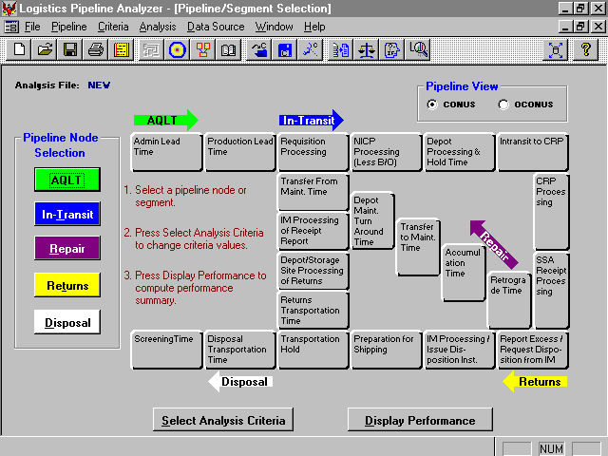
The user selects a pipeline segment or node for analysis by clicking on a button or on an arrow.

Slide 59
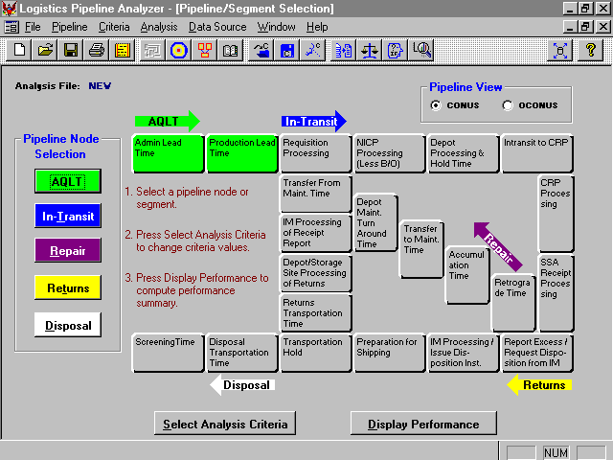
The user may select another pipeline segment or node, select analysis criteria or display performance.

Slide 60
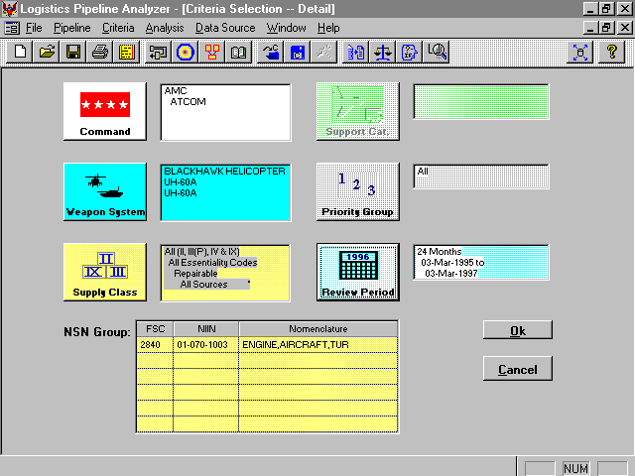
The Analysis Criteria selections are displayed for review before proceeding with the analysis.

Slide 61
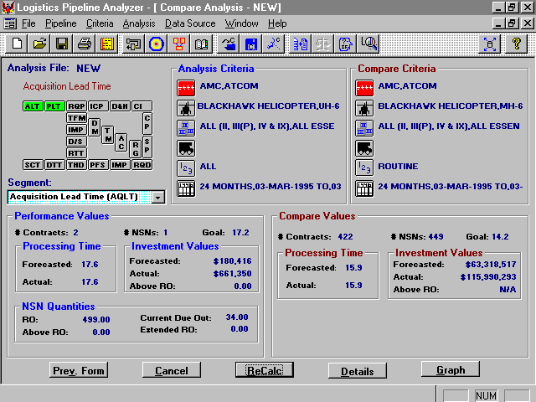
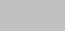
ALT
14.2
14.2
20.1
206,043
$83,230,000
20.9
The Compare Values suggest that the excessive AQLT is a SOS-wide problem and not unique to NIIN 01-070-1003.

Slide 62
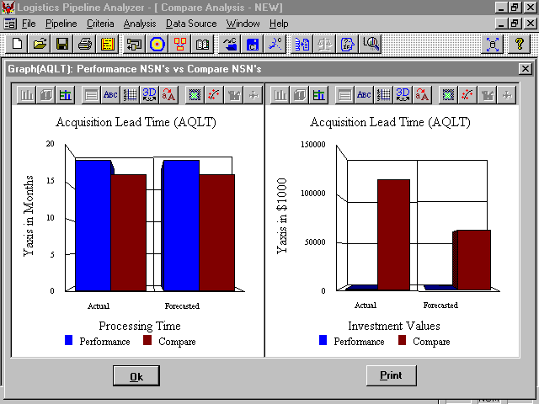
20.1
20.9
17.6
15.9
$83,230.0K
$63,318.5K
$180.4K
$206.0K
The comparison of Processing Times and Investment Values may be viewed graphically.

Slide 63
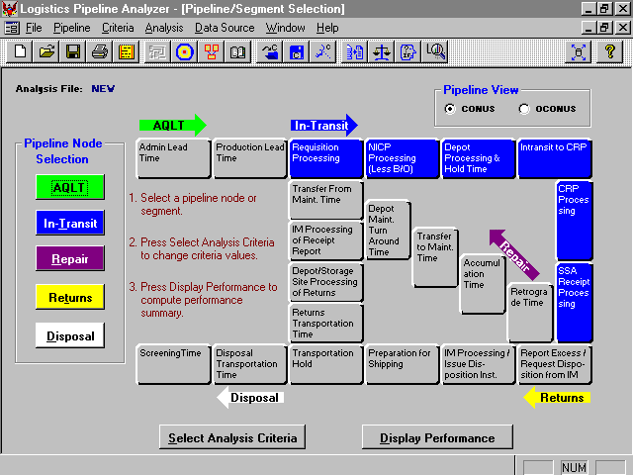
The user may select another pipeline segment or node, select analysis criteria or display performance.

Slide 64
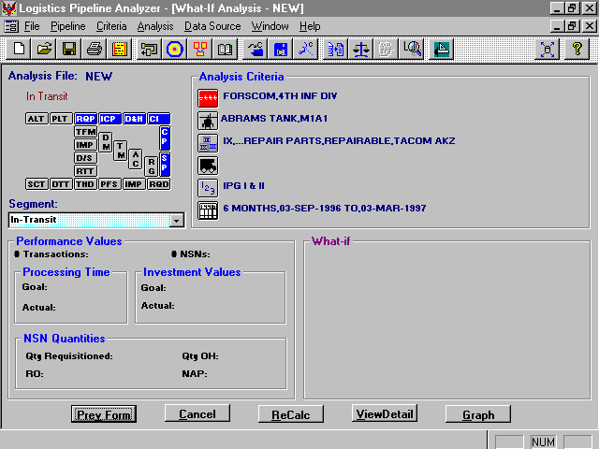
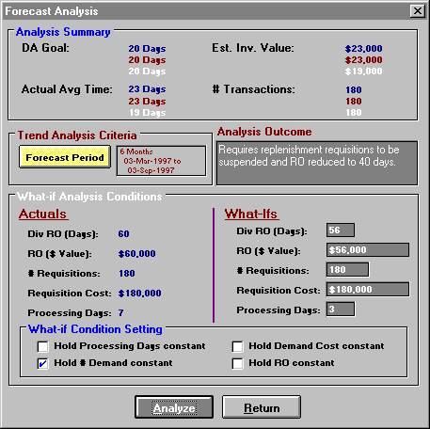
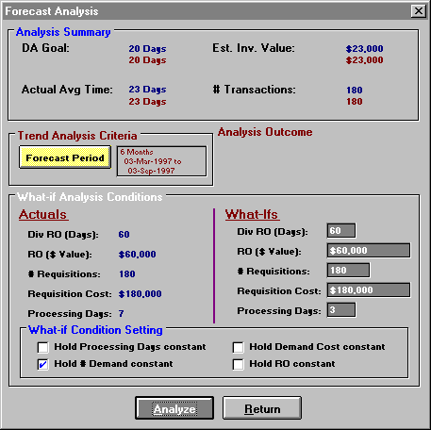
S P
180
1
20 days
$20,000
23 days
$23,000
57
Reducing processing time will reduce Investment $ by only $3,000. If additional $ are required, consider suspension of replenishment requisitions and arbitrary reduction of RO.
57,000
180
18
60
60
20
20
The What If settings are Hold # Demands Constant with the Processing Days set to 20. Results do not show big $ savings.

Slide 65
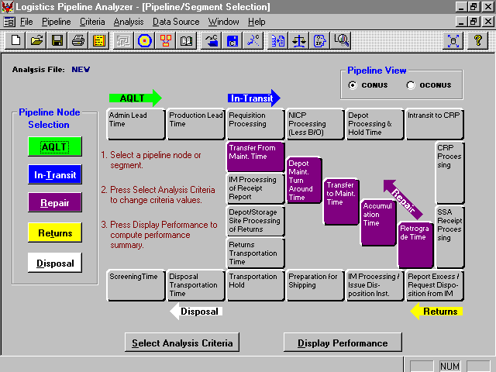
The user selects the Repair pipeline segment or node for analysis by clicking on a button or on an arrow.

Slide 66
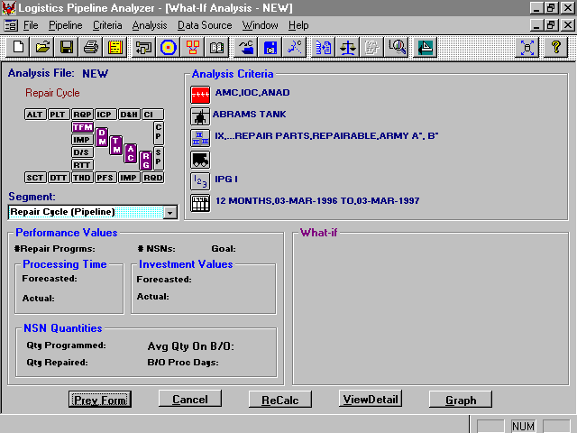
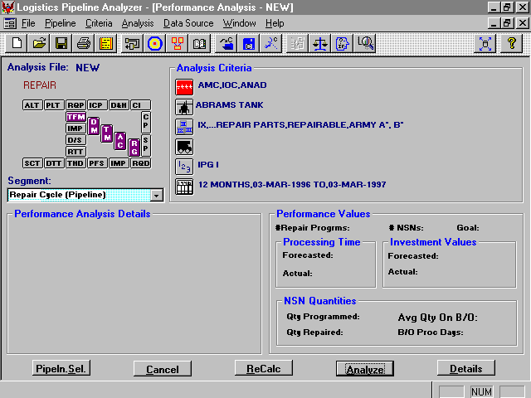
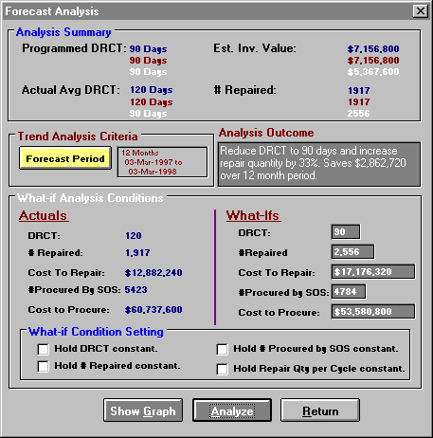
12
16
90 days
90 days
$5,367,600
120 days
$7,156,800
90
90
Reducing DRCT to 90 days while holding the repair quantity per cycle constant results in a 33% increase in quantity repaired in 12 month period and results in a net savings of $2,062,720
from reduced procurement.
1917
2556
$17,176,320
2400
$12,882,248
N/A
5423
4784
1917
N/A
$53,588,800
$60,737,600
The What If condition settings are displayed. Hold Repair Qty per Cycle constant is selected and DRCT is set to 90.

Slide 67
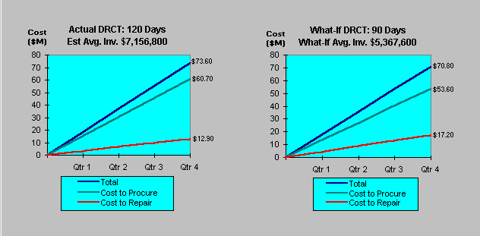
(DRCT) Actual Performance versus What If Performance
20.1
20.9
17.6
15.9
$83,230.0K
$63,318.5K
12
16
90 days
90 days
$5,367,600
120 days
$7,156,800
$180.4K
$206.0K
90
90
Reducing DRCT to 90 days while holding the repair quantity per cycle constant results in a 33% increase in quantity repaired in 12 month period and results in a net savings of $2,062,720
from reduced procurement.
1917
2556
$17,176,320
2400
$12,882,248
N/A
5423
4784
1917
N/A
$53,588,800
$60,737,600
The What If condition settings are displayed. Hold Repair Qty per Cycle constant is selected and DRCT is set to 90.

Slide 68
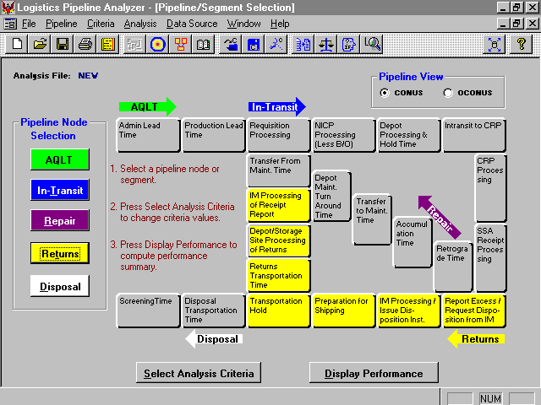
The user may select another pipeline segment or node, select analysis criteria or display performance.

Slide 69
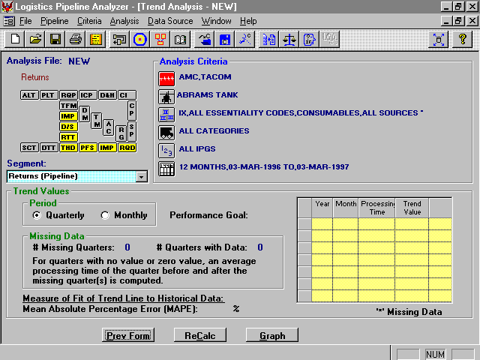
PFS
RQD
60 days
95
Jun
90
95
Sep
82
4
95
Dec
76
96
Mar
61
96
Jun
58
96
Sep
55
3.2
The Trend Analysis outcome suggests that Returns processing time will get well within six months (I.e. drop to 55 days).

Slide 70
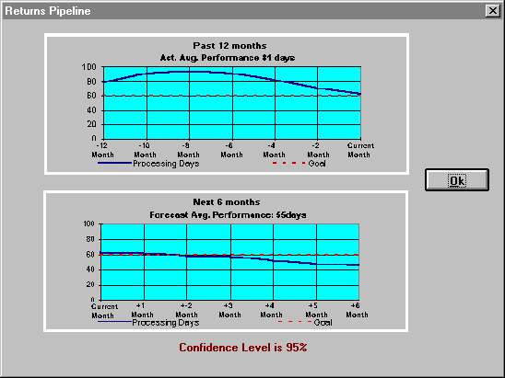
PFS
RQD
60 days
95
Jun
90
95
Sep
82
4
95
Dec
76
96
Mar
61
96
Jun
58
96
Sep
55
3.2
The Trend outcome may be displayed graphically.

Slide 71
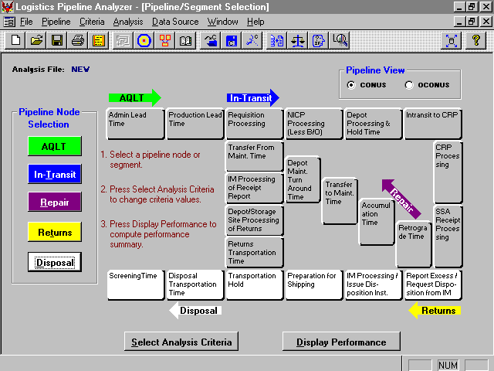
The user may select another pipeline segment or node, select analysis criteria or display performance.

Slide 72
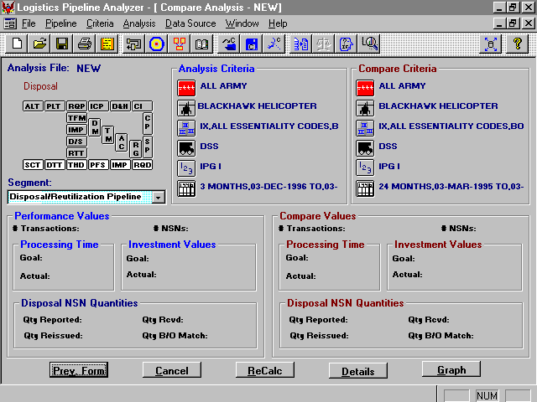
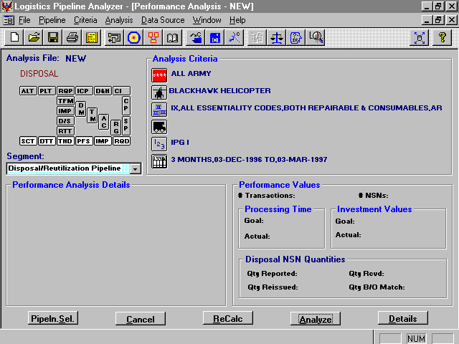
2,825
728
10,700
728
60 days
$3,283,800
60 days
$3,283,800
56 days
$3,066,560
58 days
$3,176,608
Avg Value in DRMO: $1,641,900
Avg Value in DRMO: $957,250
Avg Value (CC A or B) in DRMO: $410,475
Avg Value (CC A or B) in DRMO: $142,809
Val of Items Disp: $1,189,325
Val of Items Disp: $4,504,700
The Compare outcome suggests that there has been big growth in disposals during past 3 months - need to investigate further.

Slide 73
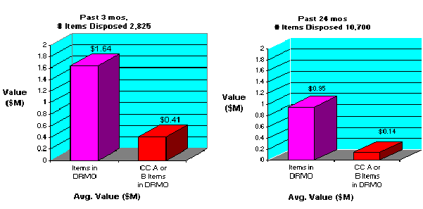
GRAPH (Disposal): Performance NSN’s vs Compare Nsn’s
2,825
728
10,700
728
60 days
$3,283,800
60 days
$3,283,800
56 days
$3,066,560
58 days
$3,176,608
Avg Value in DRMO: $1,641,900
Avg Value in DRMO: $957,250
Avg Value (CC A or B) in DRMO: $410,475
Avg Value (CC A or B) in DRMO: $142,809
Val of Items Disp: $1,189,325
Val of Items Disp: $4,504,700
The Compare outcome may be displayed graphically.

Slide 74
Key Concepts in Data Analysis
Determining the its quality and availability
Providing insights into operations
Understanding its usability and impacts in a decision model
Ensuring it is representative of the operating environment
Business complexity, objectives, availability of data, and time frame for development will dictate what methods are used.

Slide 75
Next Class
Homework #1 Due – Before class on 9/18

Slide 76
IMSE 991 Multiple Criteria Decision Making
Lecture 3
Metrics and Data Analysis

